Slide 1
Vasona
New process
Andy Griffin, August 2011

Slide 2
Objectives
New process options for radiated emissions
Plans for implementation
Other new features
List of bug fixits..

Slide 3
New process
Capture during rotation | During preview scanning, the second trace is used to capture data ‘real time’.. Vasona then processes the data and gives the max azimuth information. In addition, the turntable data for each frequency in the ‘found peaks’ lists is available.
Quick formal test… | Based upon the max azimuth, only the tower is changed during the maximization process.. Initially, formal list is sorted based upon azimuth (not on margin) hence the number of turntable rotations is limited.
Different results | A different maximum may be found because the number of ‘turntable’ slices is increased. Formal testing times are dramatically decreased. Better visibility of the azimuth data…

Slide 4
New process
Issues | Capture data as quickly as possible, could use slower turntable rotation during prescan. Operate single sweeps continuously Agilent analyser are quicker than Rohde & Schwarz Preselectors should not be used, they slow the scan. If they have to be used, then the old process may be better. Limit the number of points in the trace.
Formal measurements | If not enough data is captured then maximum azimuth may be wrong (hence need to look at the data to see if sufficient information has been recorded. Because the formal list in sorted by azimuth and it is a marginal product, worst case may not be tested first !

Slide 5
New process
ECSI/ESU | ESCI sweeps slowly… May need to use an external pre-amp, because the pre-amp is in the same path as the preselector (this is also true for some ESUs).
PXA/MXE | Can not do the 2 trace process. They are working on a firmware update. Will eventually do a fix in Vasona to get around the problem.
74xx/93EM 8566 etc…. | We not checked functionality, but unlikely to be effective because of the speed of the devices.

Slide 6
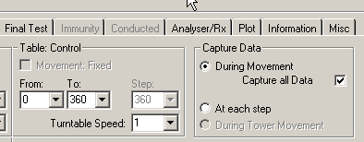
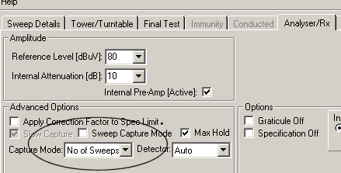
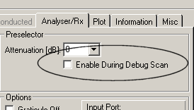
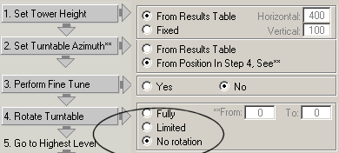
New process
Options | Capture during.. Single sweep mode
No preselector
No turntable maximisation
during formal

Slide 7
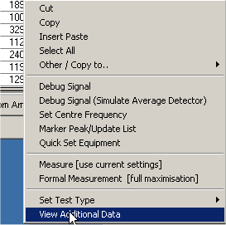
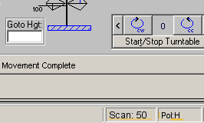
New process
Options
View data
Realtime feedback

Slide 8
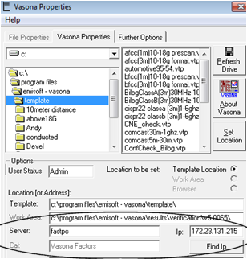
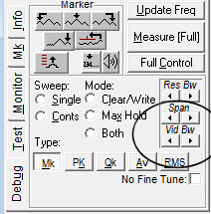
New features
IP address for ‘fast pc’ | Allows more flexible access to fastpc using the IP address. Accessible through Vasona properties.
Simple access to changing video bandwidth | Replace ‘scroll’ with Vid BW, works just like the Res BW change.

Slide 9
New features
Dongles | 64 Bit driver of dongles available, hence can use in in Win 7, but only with a new dongle. When using in Win 7 make sure program is run in WinXP SP3 emulation mode. Most of the functionality will then work correctly.
Error check | Added an error check to ensure tower/turntable are attached to the IEEE bus (if required)
SVSWR | Site VSWR calibration has been added. (Above 1GHz cal needed to satisfy CISPR 16). Further verification is needed, but most of the functionality is there. Need to do a driver for more network analysers. Once there, we could try to develop the ‘iso-tropic’ field probe method.
ESU/ESCI | Improvements in single sweep mode functionality.
MXE/PXA | Driver complete for basic PXA analyser. Need to added the receiver control for the MXE.

Slide 10
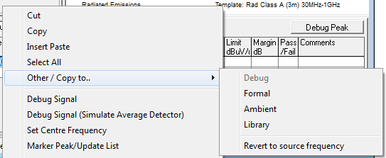
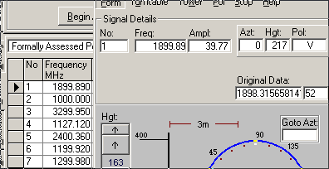
New features
Recall original | With recording the turntable azimuth data during pre-scan, had to link the debug frequency to the formal measurement…. Added a feature so that you can ‘revert’ back to the original.. Ie if you accidently change the frequency to another value, then it is simple to revert back to the original.

Slide 11
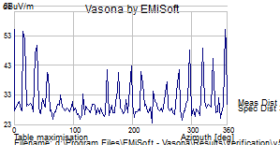
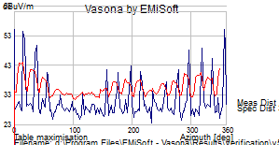
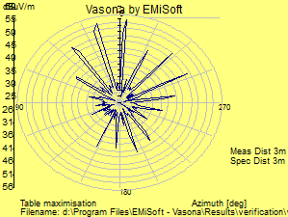
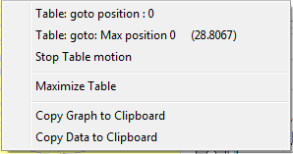
New features
More plot functions | Double clicking on the plot in the test equipment control window.
Standard
Moving average (+5dB)
Polar
Do not forget the
right mouse button

Slide 12
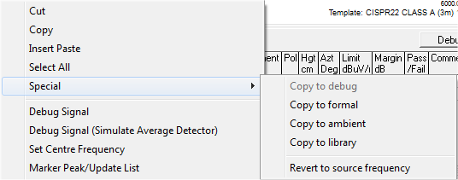
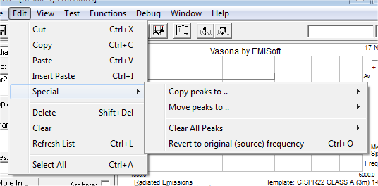
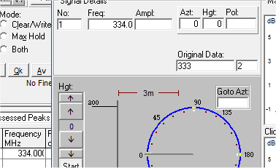
Linked debug/formal results
Linked | To allow Vasona to plot results from a combined debug and formal test, there needs to be linkage between the results in the debug and the formal TABs.
Copy results | This is done by the use of a reference (after the frequency)… so if you copy results the between the two tables this reference will be copied also, eg…. 30 (1)… 35.4 (2) etc. Vasona also records the value of the frequency when this reference is first set. You can revert back to this frequency if an error occurs… This is example 333 was the originating frequency..

Slide 13
Bug fixits…
Rounding | Decimal point rounding error in test list. The frequency was round based upon how the edit was ended.
Marker | Marker function not correct when copying and moving some trace data.
Version checking | Vasona will not complain, providing the version of software is greater than or equal to the reference version on the web, not just equal to….

Slide 14
Summary
New process works, and can deliver quicker and more comprehensive results
Need a set of templates to help implementation.
New plotting, access to original frequency, IP address for fast pc access ..….. changing video bandwidth is simplified.
Several bugs were removed….
For additional information see : http://www.emisoft.co.uk or contact emc@emisoft.co.uk

